Slide 1
Final Project Presentation
Suyash Shrivastava
DNSC 6290
Natural Language Processing
December 16th 2022

Slide 2
Overview
Idea behind the topic for the final project
NLP concept used
Data scraping, data cleaning and pre-processing steps
Model building and choosing coherence value
Visualizing the top 10 topics and some observations
Q/A

Slide 3
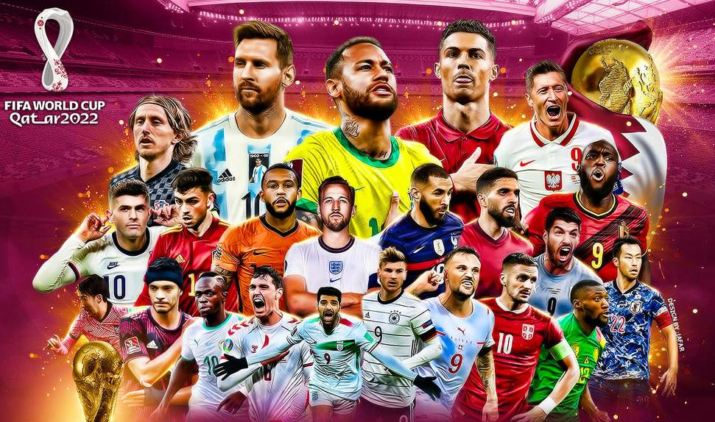
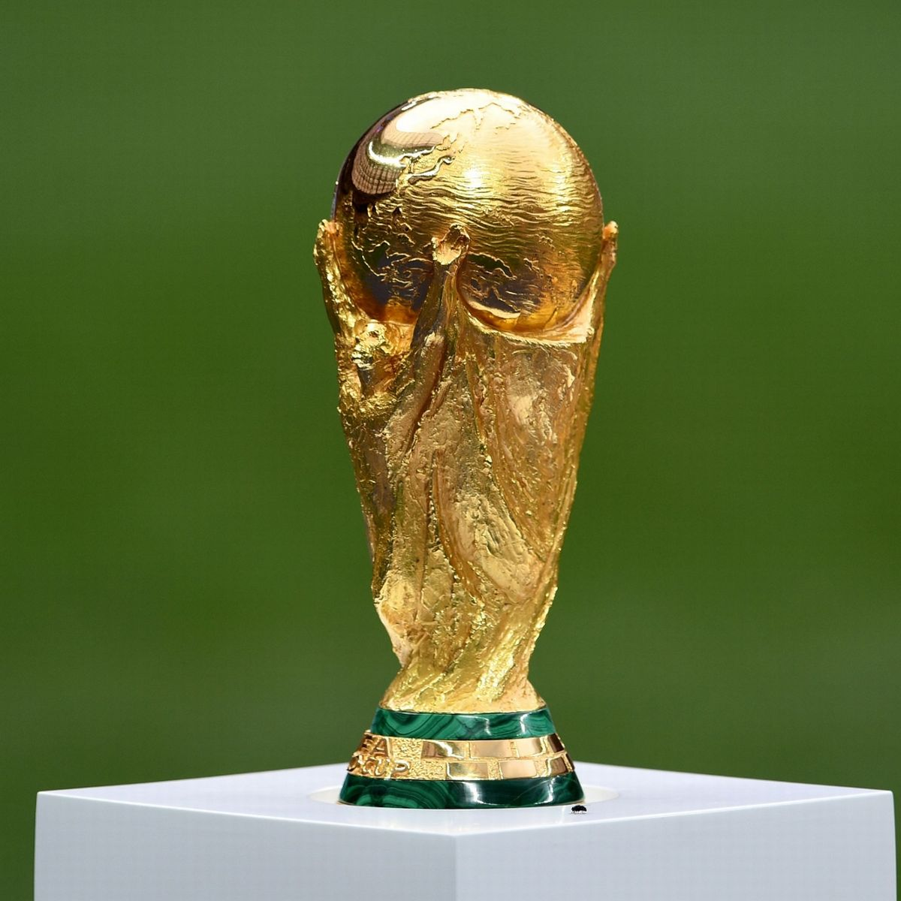
Visualizing top 10 topics of discussion between December 1st to December 9th on Twitter using #FIFAWorldCup2022
Image courtesy: Google Images

Slide 4
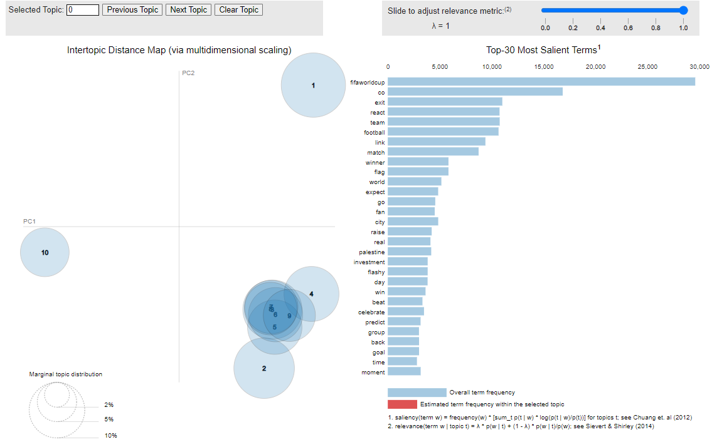
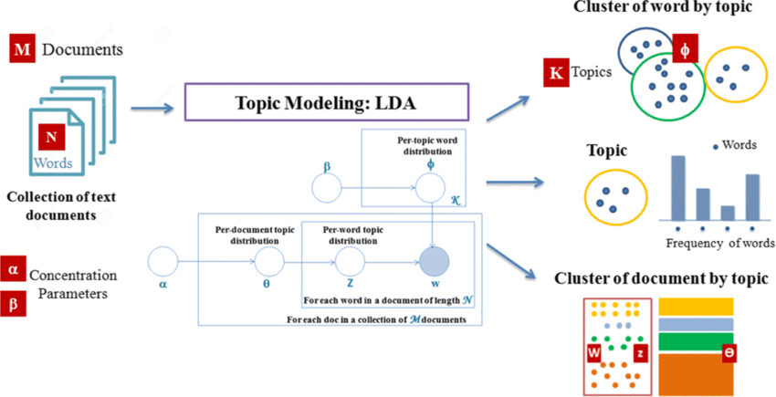
NLP concepts used
Topic Modelling using LDA
Preprocessing, Lemmatizing etc
Visualization using pyLDAvis

Slide 5
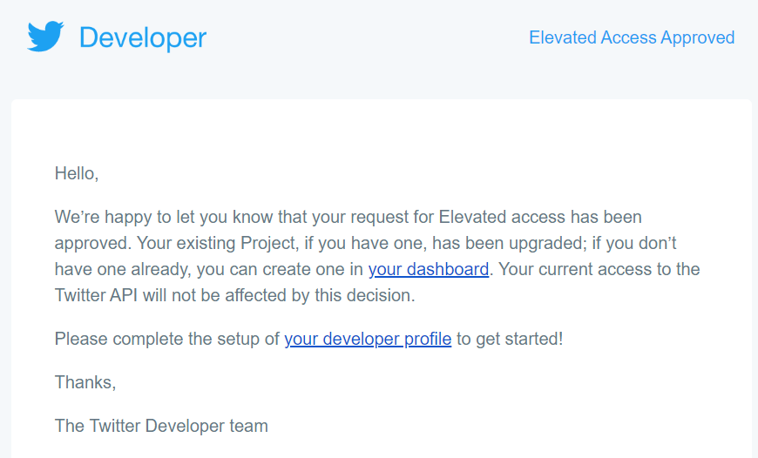

Data scraping
Requested for an ‘elevated access’ on my developer twitter account to scrape tweets.
Used the Tweepy API to scrape tweets between December 1st to December 9th 2022 in English language with #FIFAWorldCup2022.

Slide 6
Data cleaning and Pre-processing steps
Cleaned the tweets/ text by removing URLs, double spaces, emojis and special characters; converted to lower string.
Tokenized by using gensim simple_preprocess.
Removed stop words and punctuations from the tweets and finally used spacy for lemmatizing the tweets.
Created dictionary and corpus of the words.

Slide 7
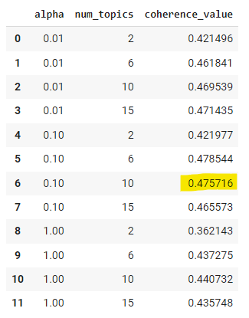
Model building and choosing coherence value
Built LDA models across a range of number of topics (2, 6, 10, 15) and alpha (0.001, 0.01, 0.1)
Generated the coherence value of each model in a dataframe.
For 10 number of topics and alpha as 0.10, coherence value is 0.475716

Slide 8
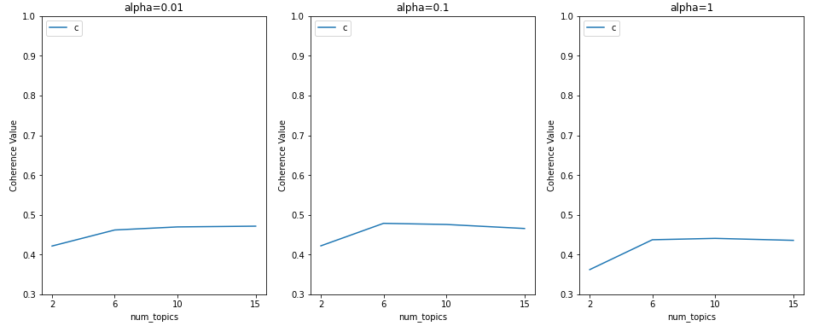
Plotting coherence value
Generating a graph to plot coherence value and number of topics for each alpha value

Slide 9
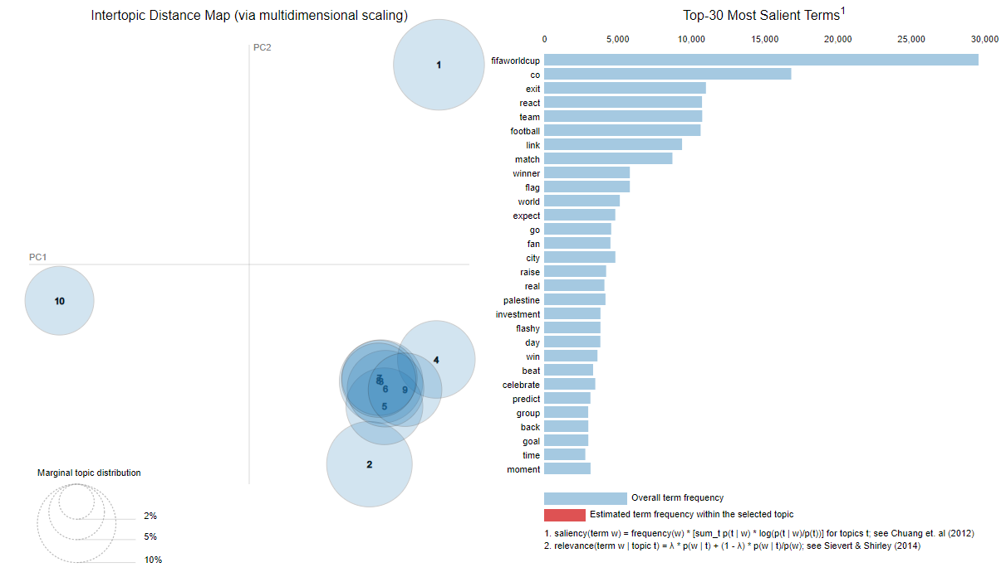
Visualizing top 10 topics
Play around the visualization yourself!
Use your GWU ID for access.
https://sites.google.com/gwmail.gwu.edu/suyash65

Slide 10
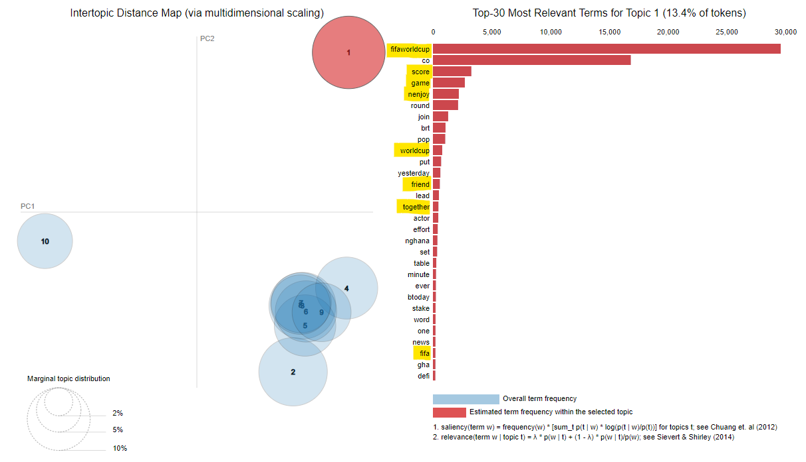
Observations
Topic 1 has words like ‘enjoy’, ‘friend’, ‘together’, ‘game’, ‘stake’, ‘score’.
Topic 1 describes how people are watching the world cup.
https://sites.google.com/gwmail.gwu.edu/suyash65

Slide 11
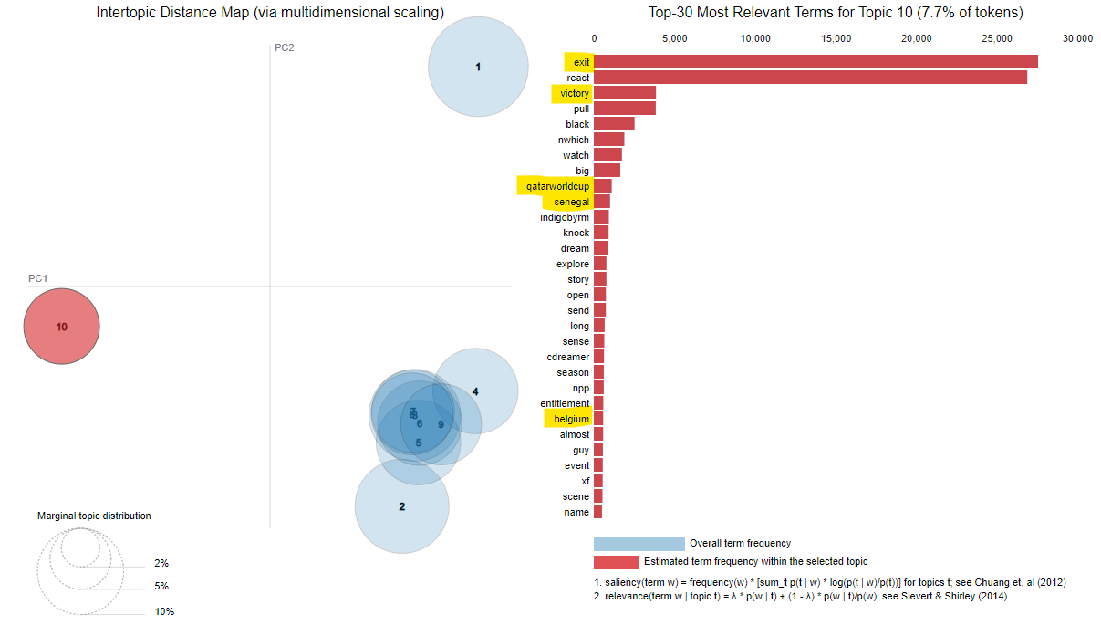
Observations
Topic 10 has words like ‘exit’, ‘senegal’, ‘belgium’, ‘victory’.
On December 1st, Belgium exited the world cup after a 0-0 draw with Croatia. Belgium were considered one of the ‘dark horse’ of this world cup.
On December 4th, Senegal was knocked out of the world cup after a 3-0 loss to England.
https://sites.google.com/gwmail.gwu.edu/suyash65

Slide 12
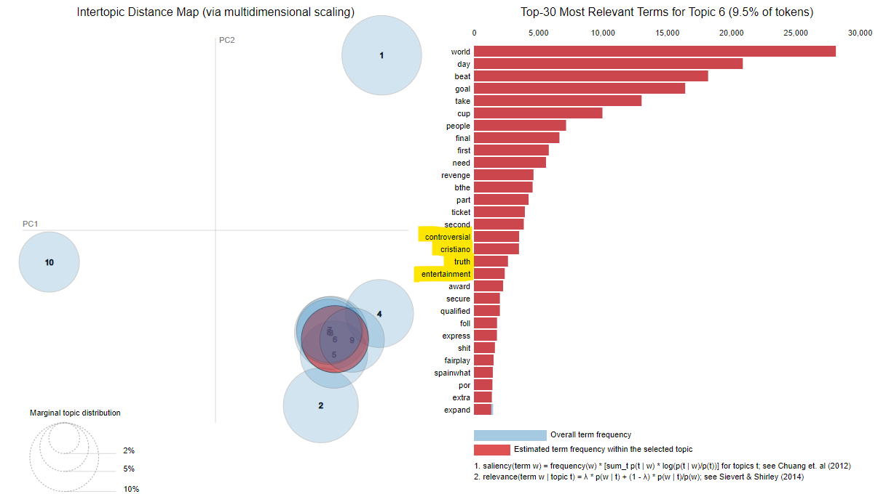
Observations
Topic 6 has words like ‘cristiano’, ‘controversial’, ‘truth’, ‘entertainment’ and ‘revenge’.
On December 6th, controversial headlines sensationalizing a rift between Cristiano Ronaldo as Portugal’s head coach before their knockout game against Switzerland went viral.
https://sites.google.com/gwmail.gwu.edu/suyash65

Slide 13
Thank you from Team 9! Any questions?
https://sites.google.com/gwmail.gwu.edu/suyash65

